Slide 1


CS 329E: Final Project
Josh Frankl, Hyunsu Kong, Jacob Martella
Notes:
Hyunsu

Slide 2
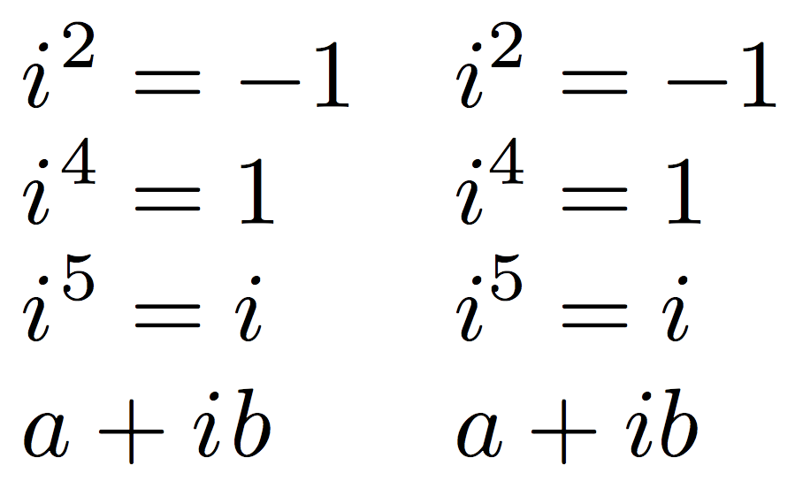
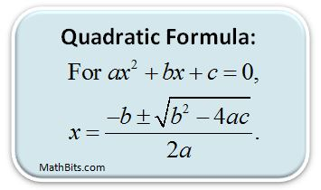
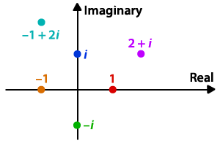
Use of the ‘exec’ Function
Java classes
Math.max()
Addition class
QuadraticFormula class
Imaginary class
Overloaded methods
Notes:
Hyunsu

Slide 3
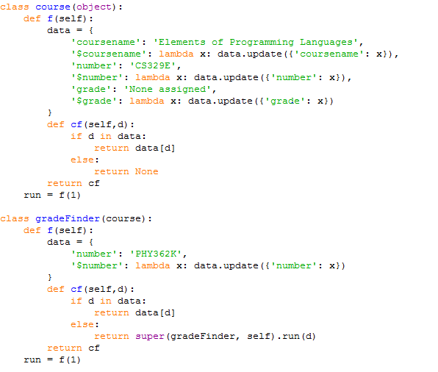
Python Closures - Courses.py
Notes:
Hyunsu

Slide 4

Java Stream Operations
ListComprehension.java
Employee data
JavaStreams.java
Reads data from files about Major League Soccer (MLS) stadiums and attendance
Notes:
Jacob

Slide 5
Python Lambda
ListComprehensionPython.py
Employee and department data
‘contains’ function
Returns True if the given number is in the list, otherwise False
‘addToList’ function
Uses list comprehension
Adds the given number to each element in the list
Notes:
Jacob

Slide 6

Swift Features
Can assign variables and constants
Can perform arithmetic operations
+, -, *, /, % and +=, -=, *=, /=
Can perform simple if/else statements
Handles "print" statement
print(), print("Hello"), print(varName), and print(3)
Notes:
Josh

Slide 7
Swift Development Tricks
commandTest.py:
Used to test an individual line of Swift code and output an abstract syntax tree (AST)
Useful in debugging
lex.py, yacc.py, and mini-lisp.py each have an optional "DEBUG" boolean
When DEBUG = True, each step in the parsing process is printed
Notes:
Josh

Slide 8
Demo
Notes:
Josh

